Slide 1
Chapter 11: Transaction managers on z/OS

Slide 2
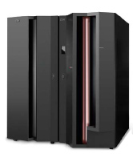
Chapter objectives
Be able to:
Describe the role of large systems in a typical online business.
List the attributes common to most transactional systems.
Explain the role of CICS in online transaction processing
Describe CICS programs, CICS transactions, and CICS tasks
Explain what conversational and pseudo-conversational programming is
Explain CICS and Web-enabling
Discuss the IMS components

Slide 3
Key terms in this chapter
Screenshot 1
BMP
BMS
conversational
CICS TS
CICS command
IRLM
multithreading
multitasking
task/thread
region
PSB
IMS TM
transaction
unit of work
two-phase commit
wireless access point (WAP)
Batch message program
Basic mapping support
Program specification block
Internal resource lock manager

Slide 4
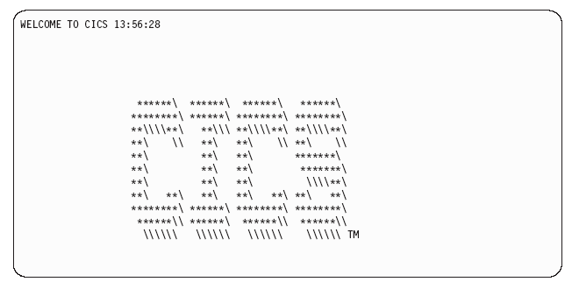
CICS

Slide 5
Example of online processing: a travel agency
Mainframe applications designed for:
  employee and customer information
  contacts with car rental companies
  hotels
  airline schedules
Changes must be immediately reflected to application end-users (in real time)
Contrast with batch processing

Slide 6
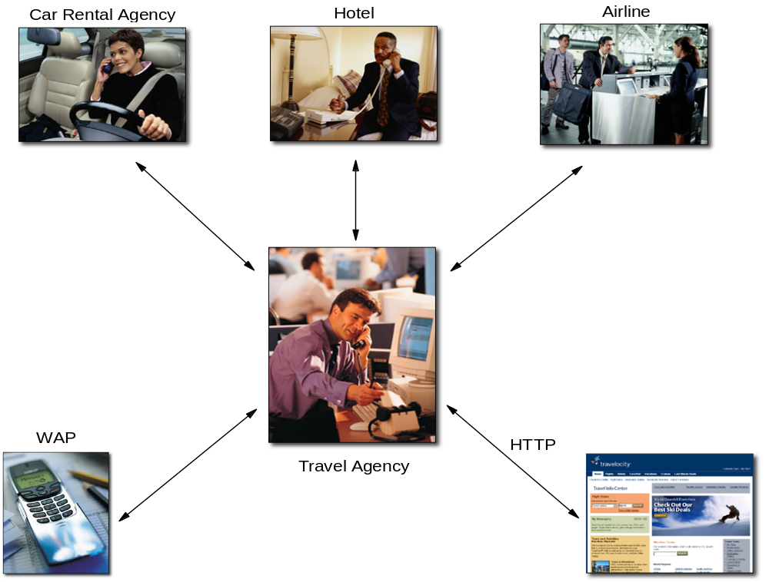
Example of online processing (continued)

Slide 7
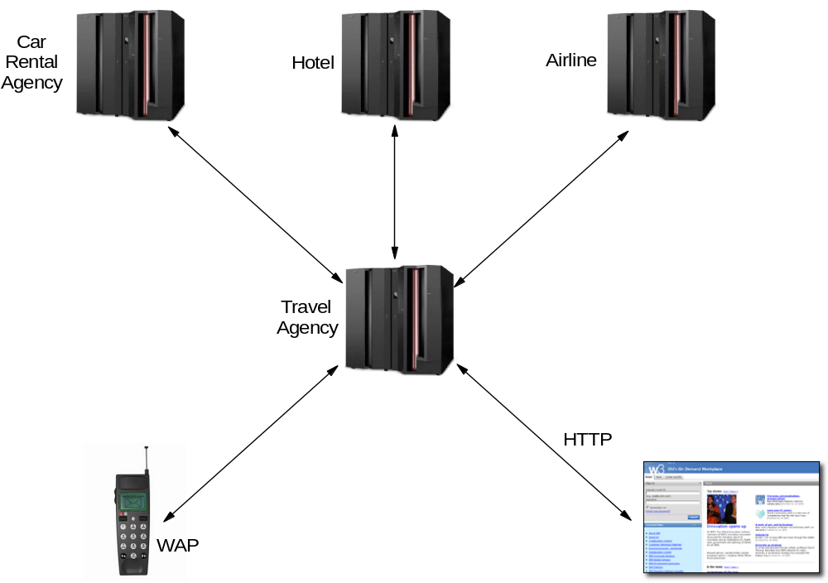
A practical example

Slide 8
Transactional systems
Requirements: ACID
  Atomicity
  Consistency
  Isolation
  Durability

Slide 9
Transactional systems: terminology
Commit and roll back
Multitasking
Multithreading
Thread
Reentrancy

Slide 10
Online Systems and Operating Systems
Managing and Dispatching tasks
Controlling user access
Managing use of memory
Managing concurrency to data
Providing device independence

Slide 11
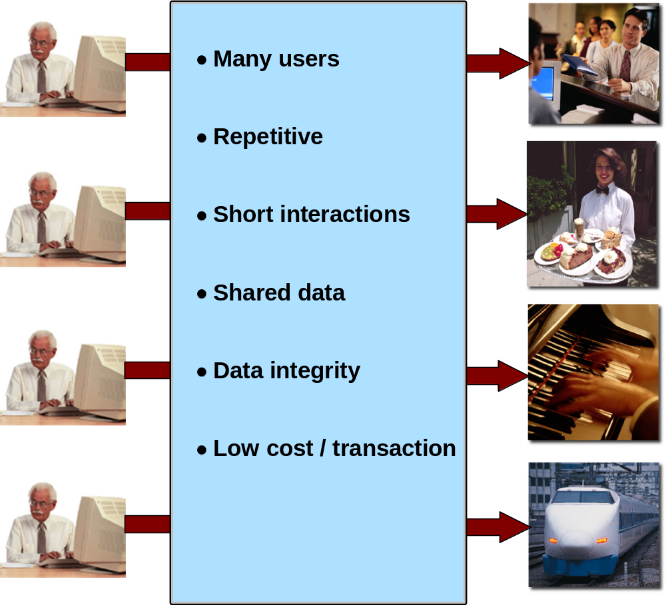
Characteristics of a transactional systems

Slide 12
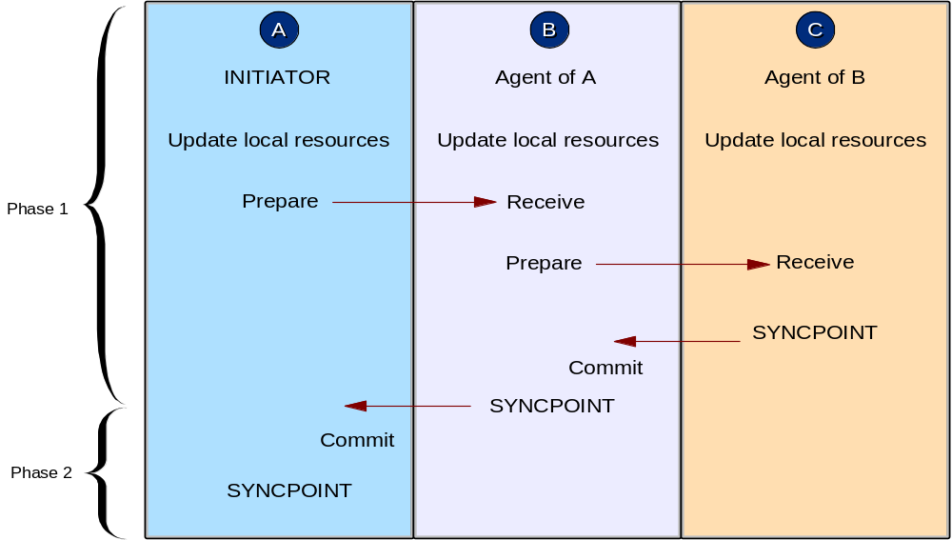
Two-phase commit
p. 407 if you want to know how it works, but you won’t be asked a question on it.

Slide 13
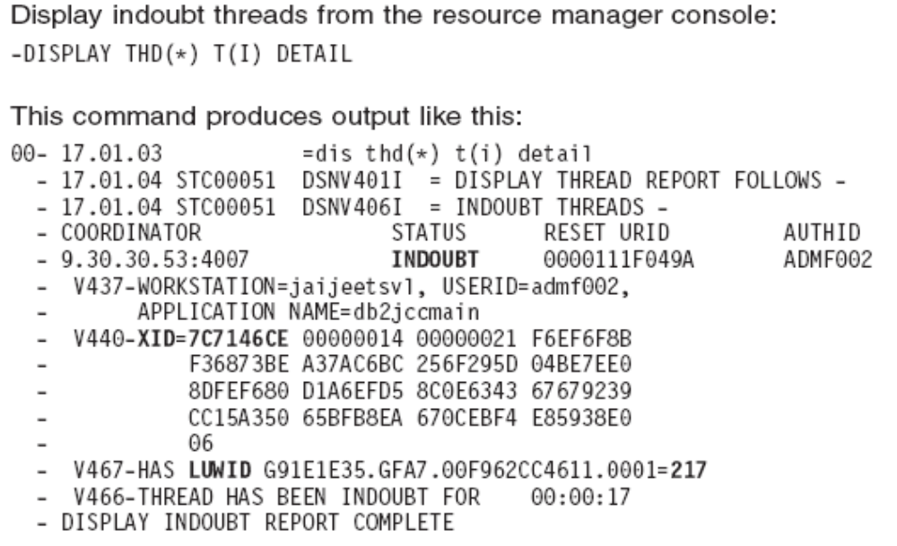
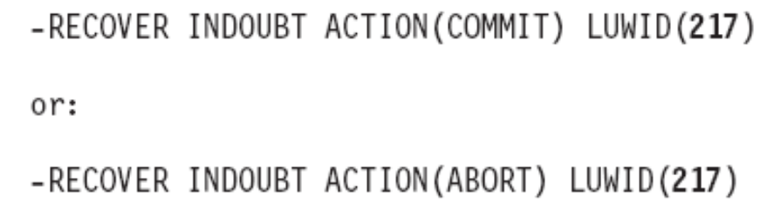
You can manage indoubt UOW

Slide 14
What is CICS?
Customer Information Control System
Transactional subsystem of z/OS which:
  run online applications
  the same time, many users, same application(s)
  manages the sharing of resources
  integrity of data
  prioritization of execution, with fast response.
Notes:
We will major on CICS to illustrate the role of transactional systems, because it is the most popular.
Then we will cover IMS briefly to give the students additional information.

Slide 15
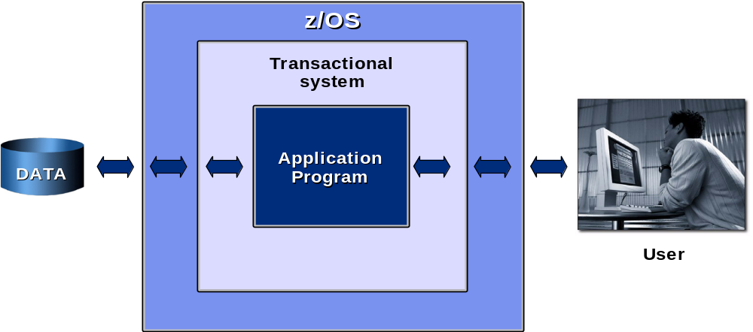
CICS in a z/OS system

Slide 16
Languages & Platforms
Languages:
COBOL
OO COBOL
C
C++
JAVA (JCICS)
PL/I
Assembler
Platforms:
zSeries (z/OS, OS/390, VSE)
Intel servers
TXSeries (AIX, HP-UX, Solaris and Windows)

Slide 17




Generating a CICS Application Program
Example: COBOL
1)
2)
3)
Source
TSO Submit
Translator
Translate
Translated
Program
Compiler
Compile
Object
Module
Link
Edit
Bind
Load
Module
//DFHRPL DD DSN=CICSV3.SDFHLOAD1,DISP=SHR
// DD DSN=CICSV3.SDFHLOAD2,DISP=SHR
// DD DSN=CICSV3.ULOADLIB,DISP=SHR
Program
Library

Slide 18
CICS Programming roadmap
Design application
Write & test program (includes compiling)
Define program & transaction in CICS resources
Define other resources (files, queues, etc…) in CICS resources (via RDO – CEDA)
Make resources known to CICS

Slide 19

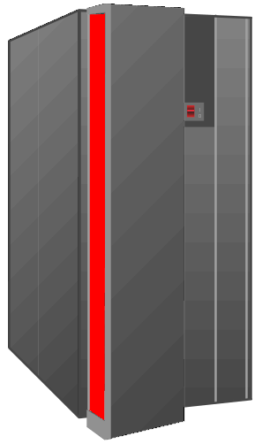
CICS in one or multiple LPARS
SYS 1
LPAR A
LPAR B
* A CICS subsystem may be composed of one or more
address spaces to isolate functionality, administration
and throughput. As an example:
- TOR = Terminal Owning Region
- AOR = Application Owning Region
- FOR = File Owning Region
- WOR = Web Owning Region
- ROR = Routing Owning region
* This is a configuration known as:
Multi Region Operation (MRO)
LPAR C
AOR
Other
Subsyst
CICS
TOR
FOR
AOR
Other
Subsyst
CICS
WOR
Other
Subsyst
AOR
CICS
CICS
Terminals
Programs
Files
Configuration
} one address space
containing all functions
SYS 2
TCT
PPT
FCT
Other
Subsyst
PCT
CICS
CICS
CICS
ROR
CICS
* CICS has strong flexibility
for business configuration
needs thru table definitions
Other
Subsyst
Inter-System Communication (ISC)
CICS
Other
Subsyst

Slide 20
CICS Programs, Transactions, Tasks and Tables
Transaction
Program Control Table (PCT)
Application Program
Program Processing Table (PPT)
Files
File Control Table (FCT)
Terminals
Terminal Control Table (TCT)
Table Definitions are usually performed by the CICS Systems
Programmer through a CICS facility called Resource Definition
On-Line (RDO). It is invoke through a CICS Transaction by
entering CEDA (CEDB,CEDC).
Configuration
TCT
PPT
FCT
PCT
****

Slide 21
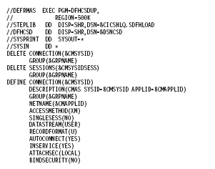
Batch RDO
Batch
RDO

Slide 22
CICS Features
Transaction Driven
Multitasking
Multithreading
Quasi-reentrant
CICS
CICS
CICS

Slide 23
A Task executing in Multi-Tasking
Task Control
Application Program(s)
Basic Mapping Support
File Control
Program Control
Temporary Storage Control
Transient Data Control
Journal Control (logging)
Trace Control
Dump Control
Interval Control
Storage Control

Slide 24
Terminal Control uses Basic Mapping Support
SEND API = displaying a screen to the terminal
RECEIVE API = reading data from a screen from
the terminal
Example:
* EXEC CICS
* SEND MAP (‘ORCHM01’)
* MAPSET (‘ORCHM01’)
* ERASE
* END-EXEC.
MOVE ‘ORCHM01’ TO DFHEIV1 MOVE ‘ORCHS01’
TO DFHEIV2 CALL ‘DFHEI1’ USING DFHEIV0
DFHEIV1 DFHEIV99 . . . .
During CICS program compile the API Commands are
checked for syntax and commented out. They are
then transformed into a starndard “CALL” to the
CICS Stub-routines.
* EXEC CICS
* RECEIVE MAP (‘ORCHM01’)
* MAPSET(‘ORCHM01’)
* INTO (workstorage area)
* END-EXEC.
MOVE ‘ORCHM01’ TO DFHEIV1 MOVE ‘ORCHM01’
CALL ‘DFHEI1’ USING DFHEIV0 DFHEIV1 …..
The DFHEIVxx variables are copied in automatically
by the CICS translator into WORKING STORAGE
i.e. DFHEIVAR COPYBOOK

Slide 25
An example of BMS map definition
The MAPS are composed of three simple macros:
DFHMSD – name of mapset
DFHMDI – name of map identification
DFHMDF – field screen definitions and location
Note: You can have several maps
within a mapset definition
PRINT NOGEN
ORCHM01 DFHMSD TYPE=MAP,MODE=INOUT,CNRL=FREEKB,LANG=COBOL,TIOAPFX=YES
ORCHM01 DFHMDI SIZE=(24,80)
DFHMDF POS=(01,01),LENGTH=01,ATTRB=(ASKIP,DRK,FSET), x
INITIAL=‘1’
DFHMDF POS=(01,25),LENGTH=3,ATTRB=(ASKIP,BRT), x
INITIAL=‘PURCHASE ORDER - - - FILE INQUIRY’
DFHMDF POS(03,30),LENGTH=13,ATTRB=ASKIP, x
INITIAL=‘ORDER NUMBER ’
ORDER# DFHMDF POS=(03,44),LENGTH=10,ATTRB=(NUM,BRT,IC)
DFHMDF POS=(04,32),LENGTH=11,ATTRB=ASKIP,INITIAL=‘DEPARTMENT’
*
*
*
*
*
DFHMSD TYPE=FINAL

Slide 26
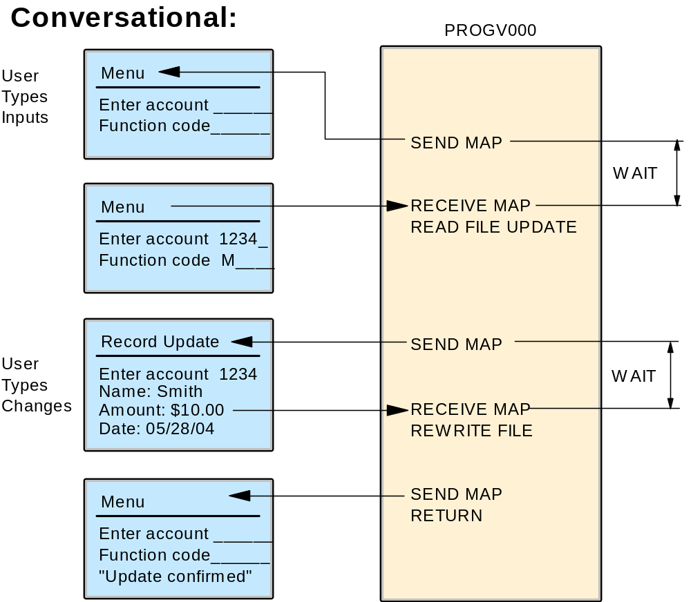
Conversational Pseudo-Conversational
P 415

Slide 27
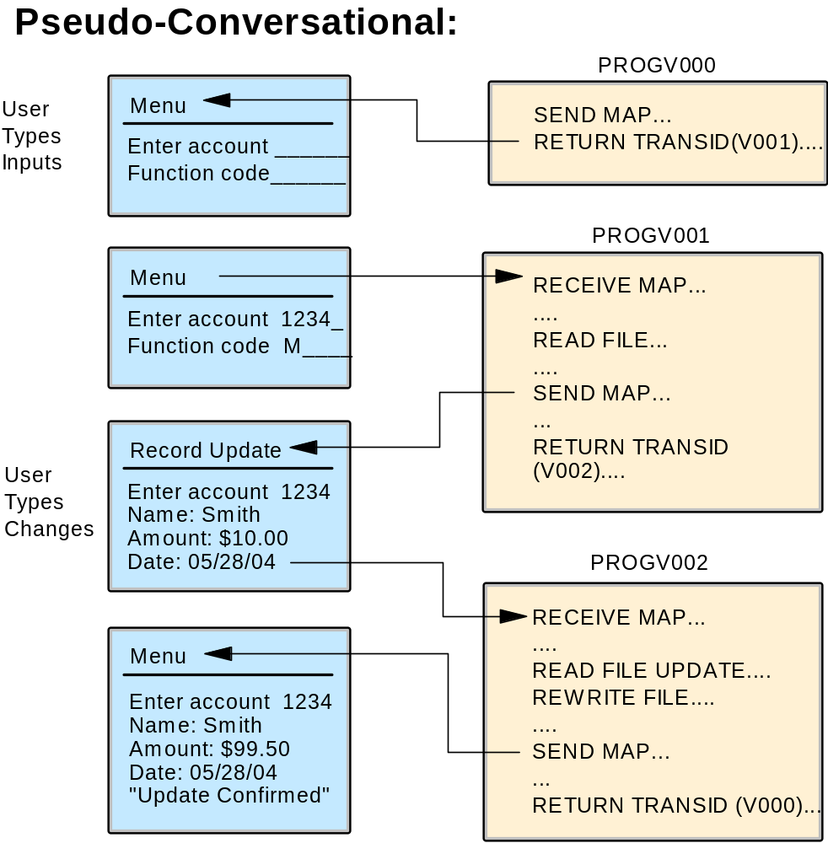
Conversational ⬄ Pseudo-Conversational

Slide 28
CICS Programming commands
General format:
EXECUTE CICS (or EXEC CICS) + command
e.g. in COBOL:
EXEC CICS function option option ... END-EXEC.
CICS command example :
EXEC CICS
READ FILE(‘ACCTFIL’)
  RIDFLD(ACCTC)
  UPDATE ...
END-EXEC.

Slide 29
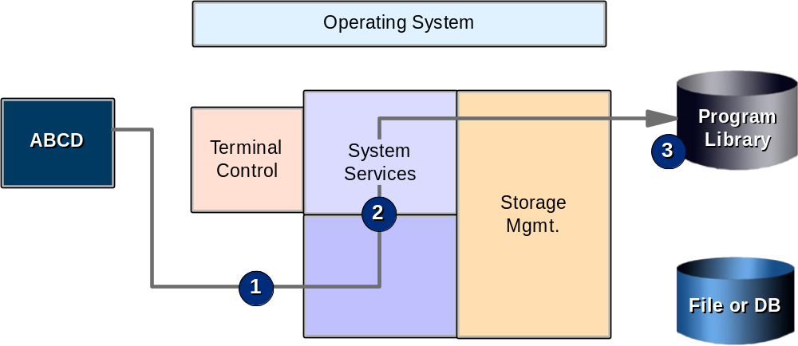
CICS transaction flow

Slide 30
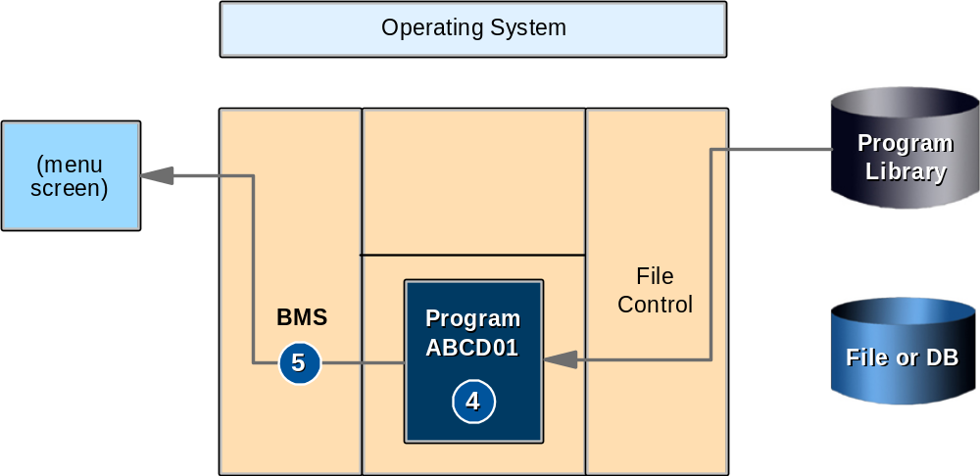
CICS transaction flow (Cont…)

Slide 31
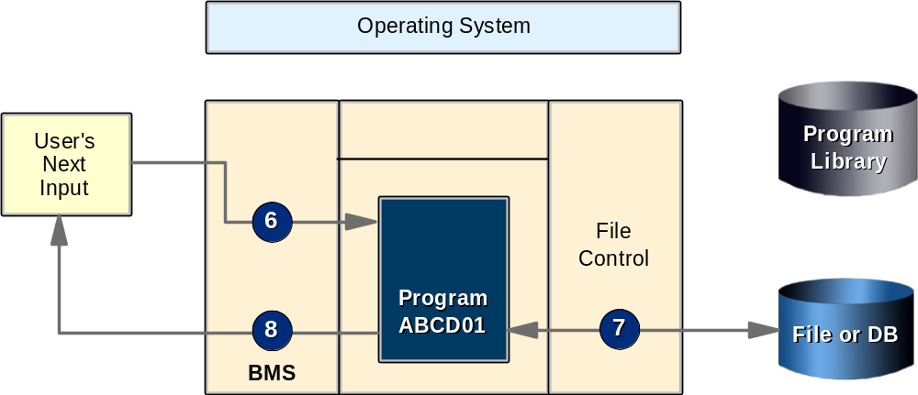
CICS transaction flow (Cont…)

Slide 32
CICS services for Application Programs
Application program interface: use CICS commands
Terminal control services: use Basic Mapping Support (BMS)
File & database control services:
  CICS file control (mainly VSAM)
  Database control (DL/I & DB2)
Other CICS Services: Task Control - Program Control - Temporary Storage (TS) & Transient Data Control (TD) - Interval Control - Storage Control - Dump & Trace Control

Slide 33
Defining the screens
BMS macros: a form of assembler language
Result of an assembles : Physical Map
Physical map contains info to :
  build the screen
  merge variable data between program & screen
  send variables back to program

Slide 34
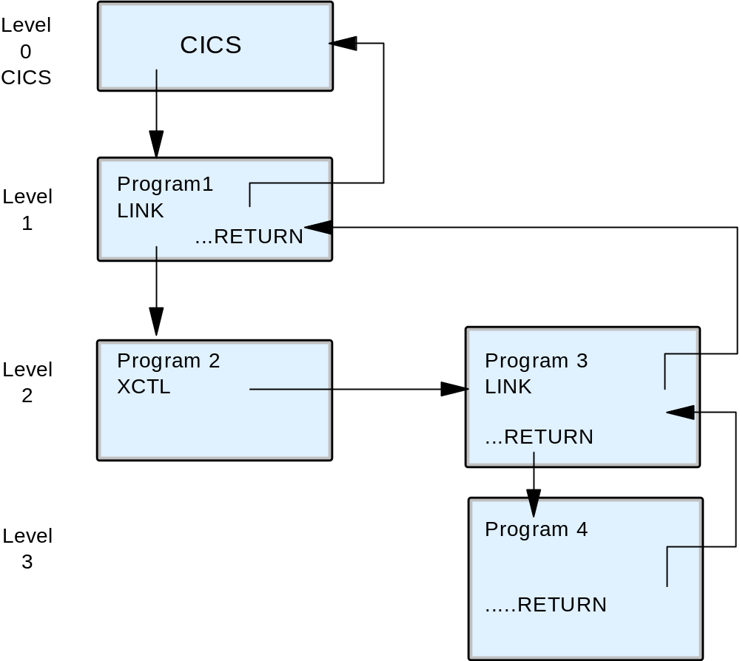
Program Control
RETURN
XCTL
LINK
LOAD
RELEASE
EXEC CICS LINK
PROGRAM(PROGRAM-2)
END_EXEC.
EXEC CICS XCTL
PROGRAM(PROGRAM-3)
END_EXEC.

Slide 35
CICS COMMUNICATION AREA (COMMAREA)
This area of a program is used to pass information between
other programs and transactions.
It is automatically provided to you via the Translator phase
In COBOL it is part of the DATA DIVISION / LINKAGE SECTION
It initially provides you one byte to be used as a programming SW
although it can range up to 32K bytes in size
O1 DFHCOMMAREA.
05 PROCESS-SW PIC X.
88 INITIAL-ENTRY VALUE ‘0’.
88 VERIFICATION VALUE ‘1’.
05 ACCOUNT-NUMBER PIC X(10).
*
*
*
EXEC LINK PROGRAM(ACCTPGM)
COMMAREA(DFHCOMMAREA)
LENGTH(11)
END-EXEC.

Slide 36
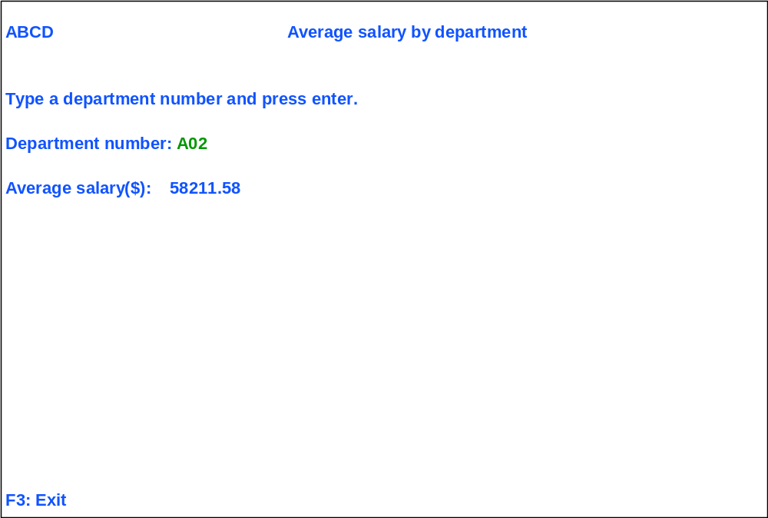
Example of CICS application user screen
You can program PF, PA, CLEAR Keys to perform any transaction functionality
i.e. EXEC CICS HANDLE AID PF3(EXIT-PGM) . . . .END-EXEC.

Slide 37
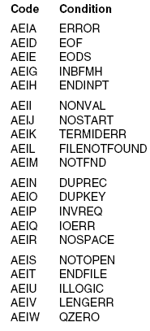
Example of ABEND Codes

Slide 38
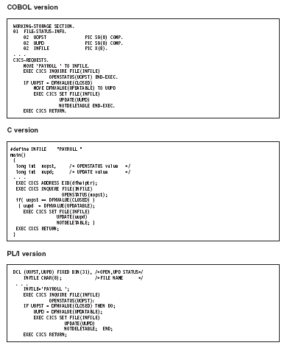
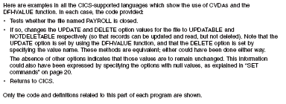
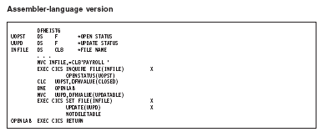
Language Examples

Slide 39
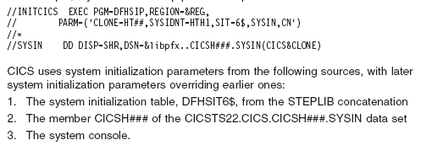
CICS JCL Startup

Slide 40
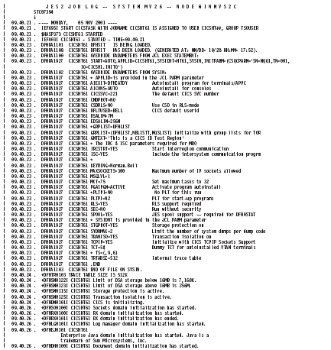
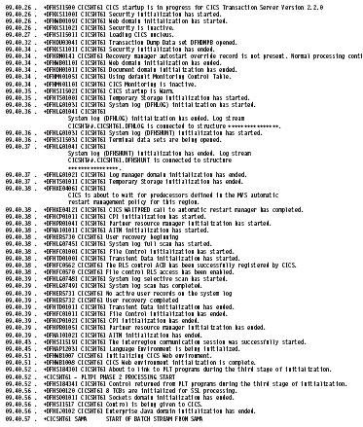
Example of CICS Startup Messages on MVS Console
Type
Of
Startup
Temp
Stg.
Init
RDO
Grouplist
being loaded
Good
Morning
Msg
Web
Listener
enabled
Storage
Size
acquired
Java
Enabled
*

Slide 41
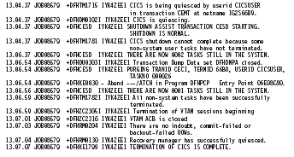
Example of CICS Shutdown Message from MVS Console
Logs
who is
shutting
down
CICS
Closing
Network
No Outstanding
Tasks
Shutdown Statistics Generated Report

Slide 42
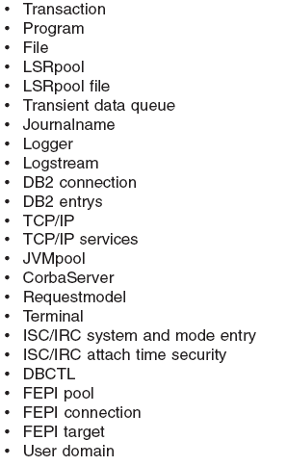
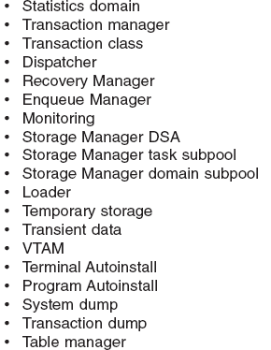
Example of CICS Statistics Collected (DFHSTUP)

Slide 43
CICS and Web-enabling
Screenshot 2
4 major elements of web-enabled applications:
Presentation logic
Integration logic
Business logic
Data logic

Slide 44
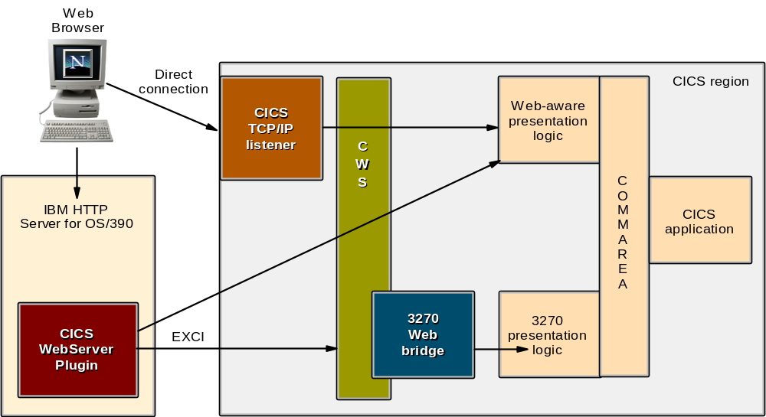
CICS Web support

Slide 45
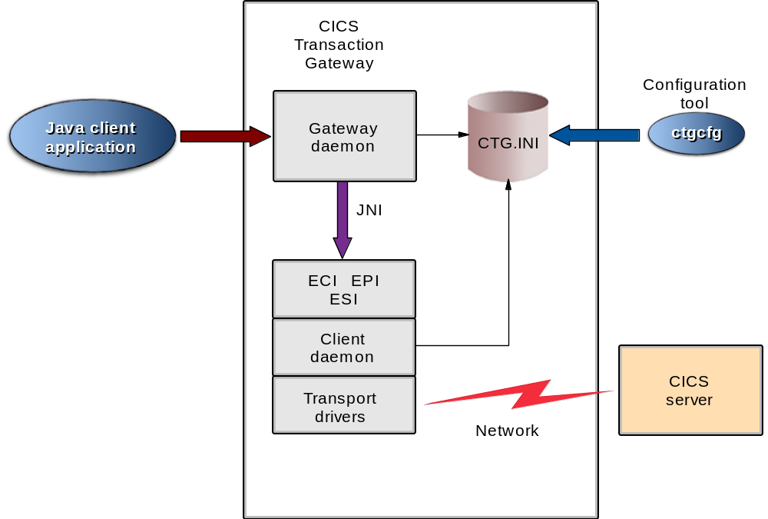
CICS Transaction Gateway

Slide 46
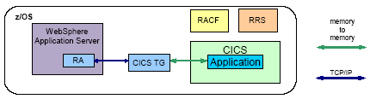
CICS Transaction Gateway and WebSphere Application Server

Slide 47
CICS COMMANDS /DEMOS
CEMT – Master Terminal Commands
* INQUIRE (set file)
* SET (disable a program)
* PERFORM (Statistics)
CECS – Command Syntax Check
CECI – Command Initiation
CEDF – EXECUTE DIAGNOSTIC FACILITY
CEDA/B/C – Resource updating via RDO
(See utility DFHCSDUP*)
CEBR – Temporary Storage Browser
CETR – Trace
CSMG - Messages
CSFE PRINT
JCL SDSF
* See next slide

Slide 48
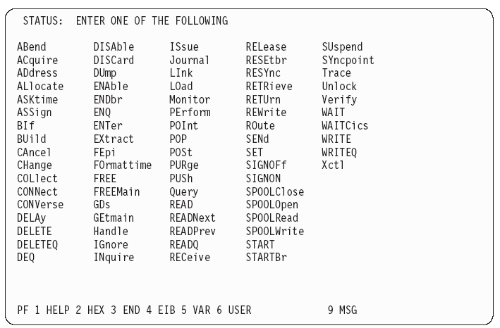
CECI

Slide 49
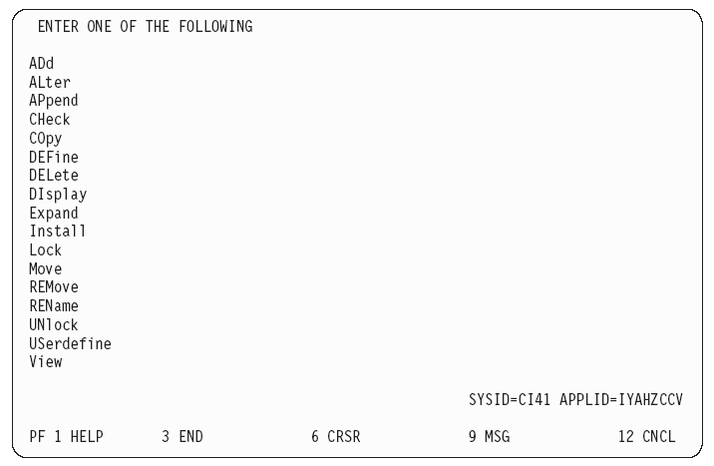
CEDA

Slide 50
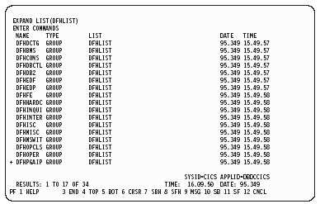
CEDA EXPAND LIST(DFHLIST)

Slide 51
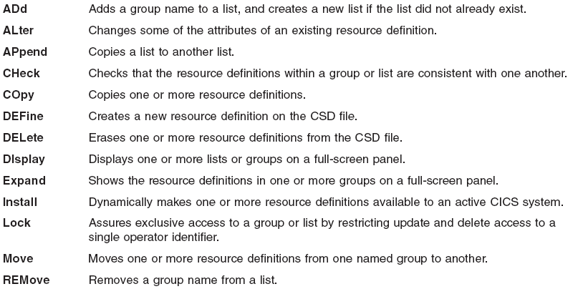
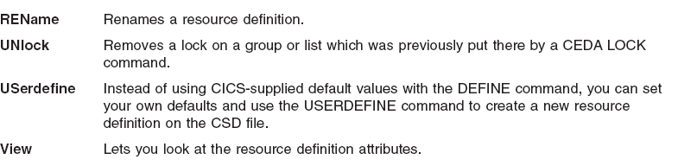
CEDA Functions for Resource Definitions

Slide 52
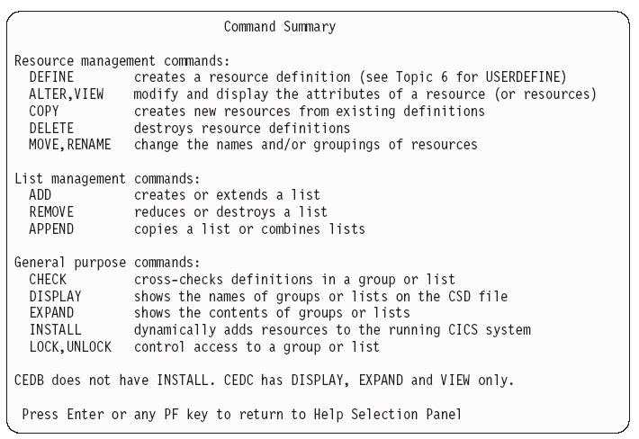
CEDA/CEDB/CEDC Summary

Slide 53
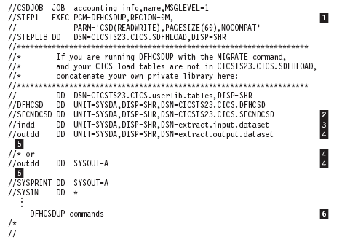
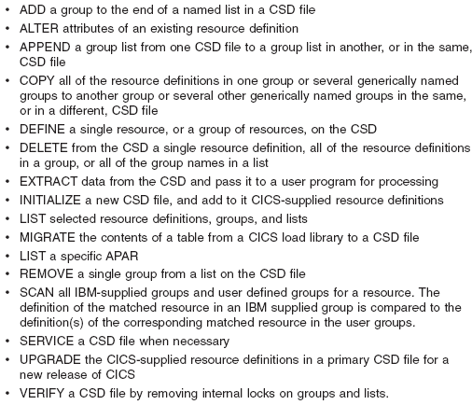
The DFHCSDUP utility provides:

Slide 54
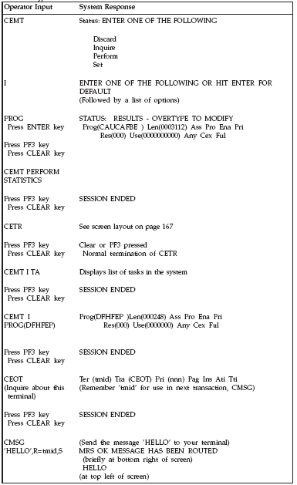
Example of Terminal Interactions

Slide 55
What is IMS?
Information Management System
3 components:
  The Transaction Manager (TM)
  the Database Manager (DB)
  Set of system services, providing common services to the other 2

Slide 56
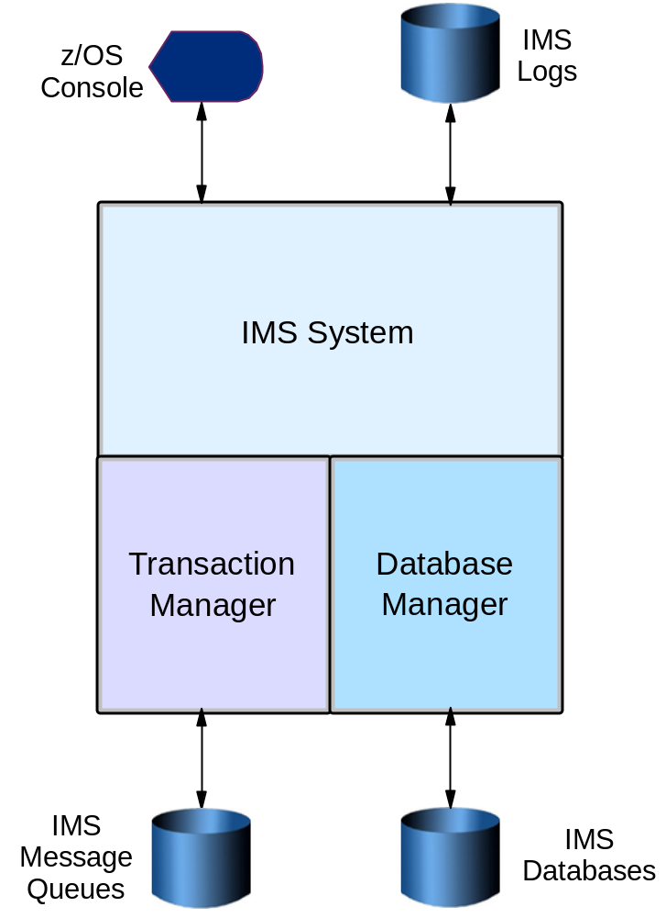
IMS overview

Slide 57
IMS Transaction Manager messages
Four types of messages:
  Transactions
  To go to another logical destination
  Commands for IMS
  For the IMS APPC feature to process

Slide 58
Summary
Interaction with the computer happens online through the help of a transaction manager.
The continued growth of the Internet has caused many corporations to consider the best ways to make their legacy systems available to users on the Internet.
CICS is a transactional processing subsystem. CICS applications are traditionally run by submitting a transaction request.
Information Management System (IMS) consists of three components:
  Transaction Manager (TM)
  Database Manager (DB)
  A set of system services common to both TM and DB

